Slide 1

Taxi optimization
Wei Wang

Slide 2


Main tasks
Present an algorithm to place employees into taxis.
Use the employee address data to compute a good set of taxi passenger configurations
Display all the assumptions
Estimate the money saved
Show my results in map or other graphs

Slide 3
Assumption
No missing or wrong values in the given dataset.
Keeping outlier
All the employee are ok with sharing taxis with others
There is a trade off between time of arriving and cost of the taxi

Slide 4

Data pre-processing
Need to understand the data that is given.
No need to do much data cleaning, since we assumed the data provided are valid.
Calculate the latitude and longitude of each address.
Put latitude and longitude in the dataframe as new attributes for further use

Slide 5
Approach to this problem
Assign as many employees as possible into one taxi (max of 4)
Divide 75 employees into 19 groups by using K-means
In each group, driver starts with the one with longest distance from the airport, then go to the second longest distance → third longest distance→ shortest distance
ANOTHER OPTION: Have a pick-up point for each group(the center of each cluster), each employee go to pick-up point by their own transports.
Calculate the fee of each employee has their own taxi and the fee of a taxi takes 4 employees
Compare fees

Slide 6
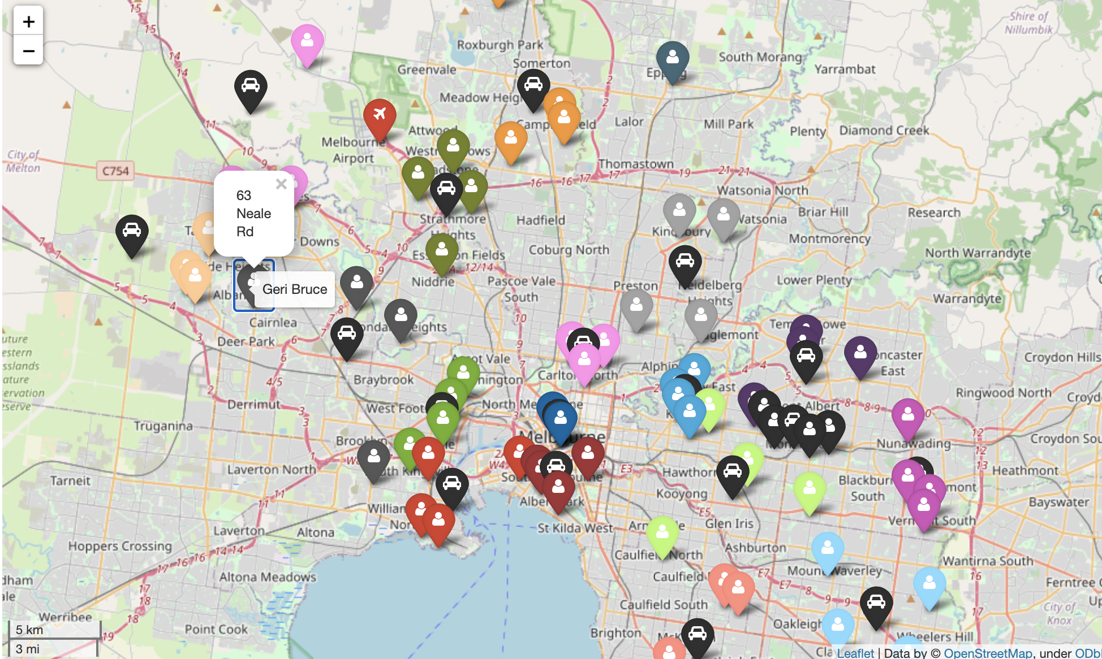
Map FOR employee address divided by k-means

Slide 7
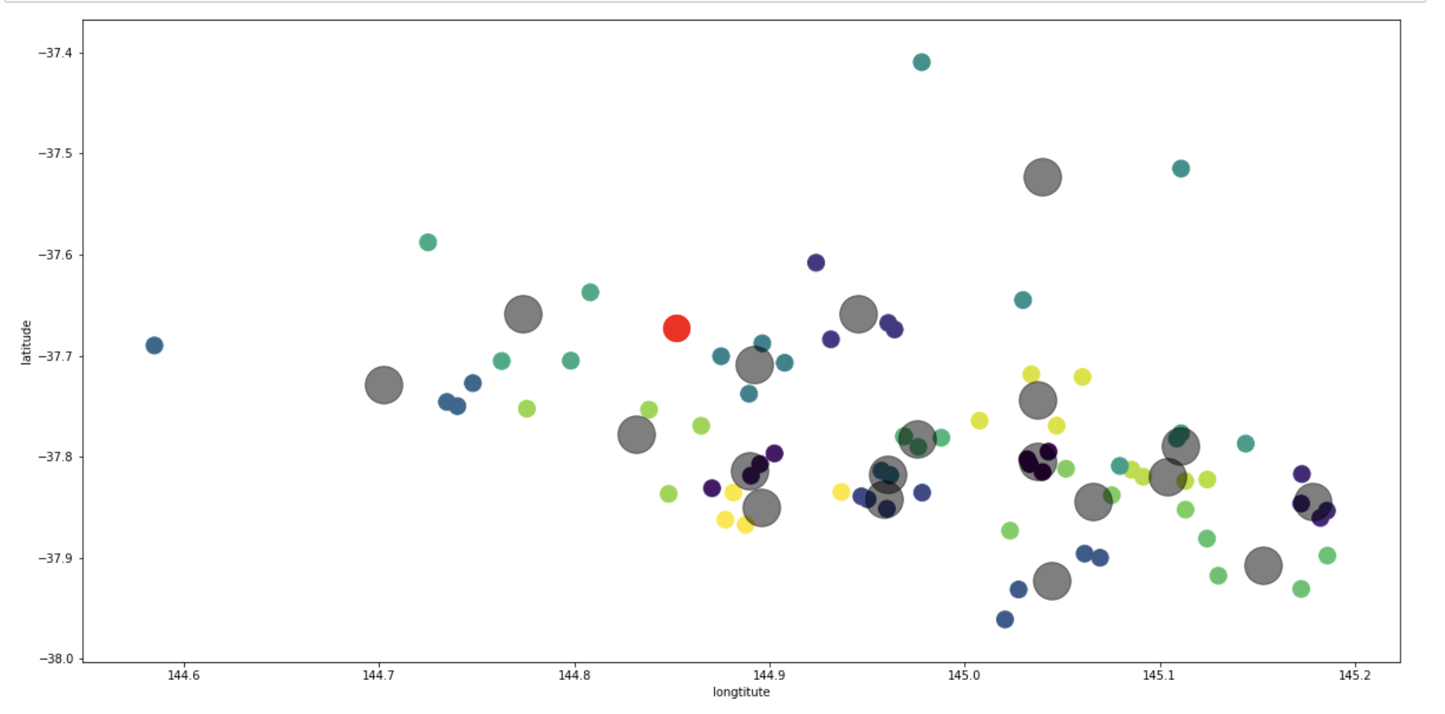
The scatter plot for k-means

Slide 8
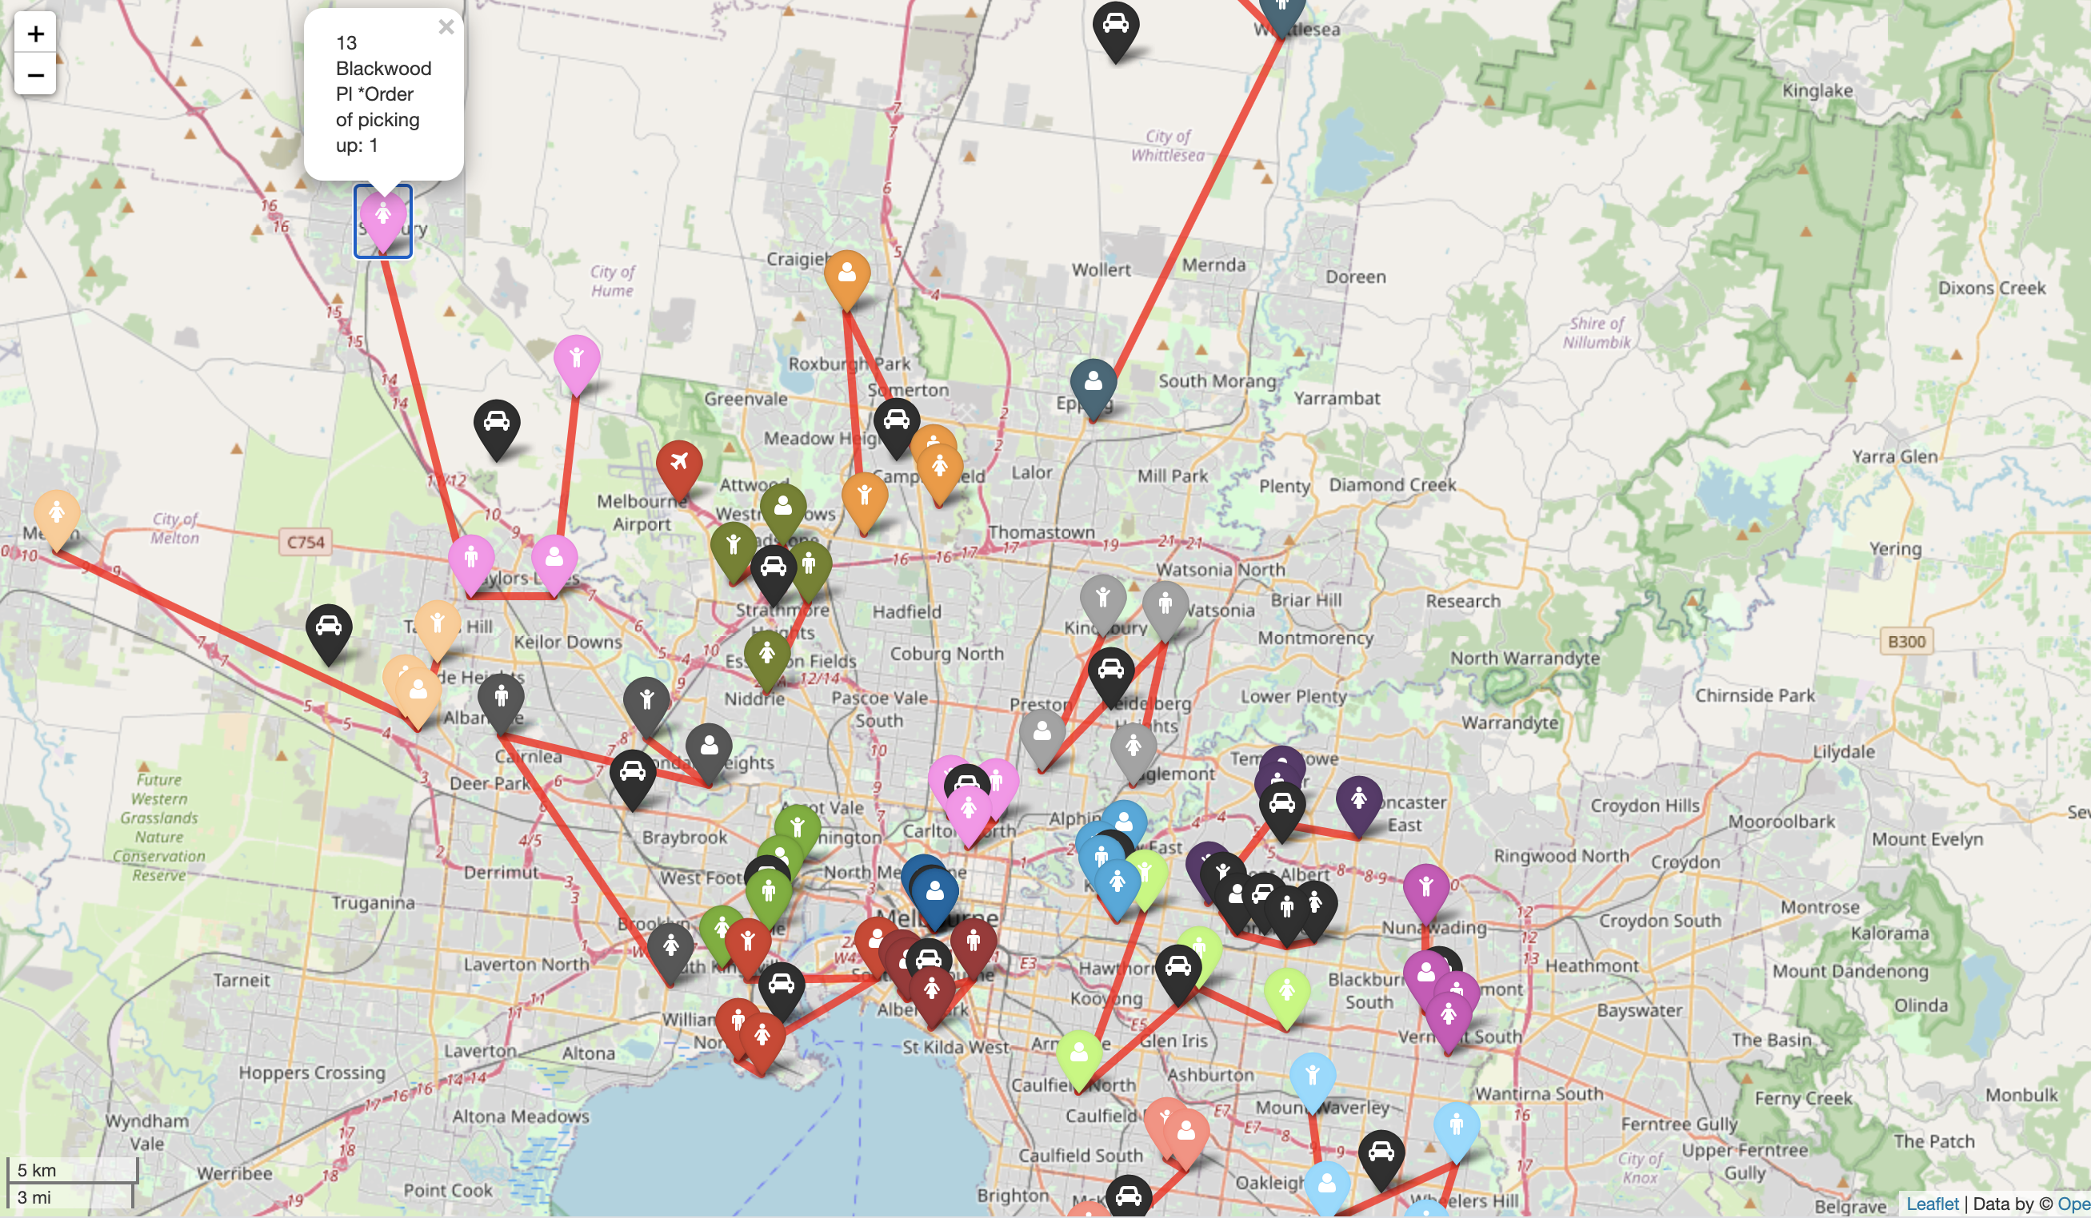
Orders of picking up

Slide 9
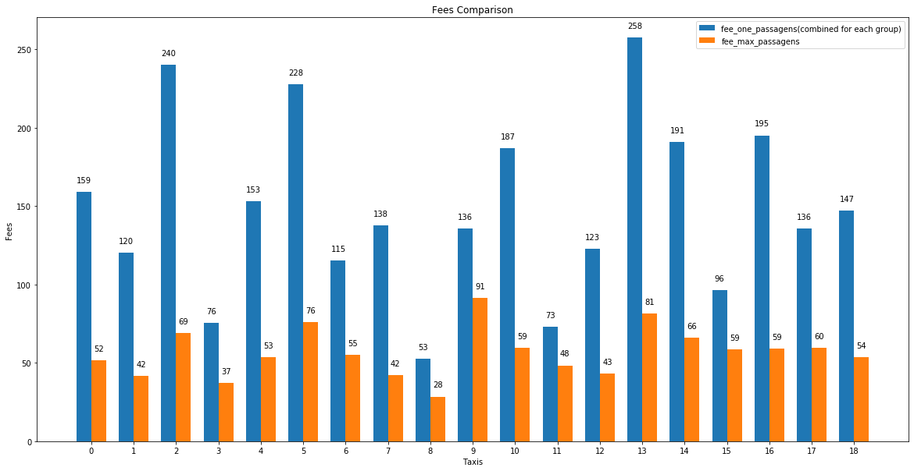
Fee Comparison

Slide 10
future steps
Look deeper into trade off between cost and time
1
Use google map API to check the duration between each address and airport
2
try different Ks for K-mean, we can use elbow method to find the best K
3
Extend the project further for larger data sets
4
Try some other Algorithms for assigning employees into one taxi
5

